Slide 1
String Matching Algorithms

Slide 2
Introduction
Text-editing programs frequently need to find all occurrences of a pattern in the text.
Typically, the text is a document being edited, and the pattern searched for is a particular word supplied by the user.
Efficient algorithms for this problem—called “string matching”—can greatly aid the responsiveness of the text-editing program.

Slide 3
Applications of String Matching
DNA sequencing : String-matching algorithms are used to search for particular patterns in DNA sequences.
Internet search engines also use them to find Web pages relevant to queries.
Plagiarism Detection: The documents to be compared are decomposed into string tokens and compared using string matching algorithms. Thus, these algorithms are used to detect similarities between them and declare if the work is plagiarized or original.
Digital Forensics: String matching algorithms are used to locate specific text strings of interest in the digital forensic text, which are useful for the investigation.
Spelling Checker
Spam Filters: search suspected spam keywords in the content of email.
Intrusion detection: Data packets containing intrusion related keywords are found using string matching algorithm . All malicious code is stored in the DB and every incoming data is compared with stored data . If match is fond, then alarm is generated.

Slide 4
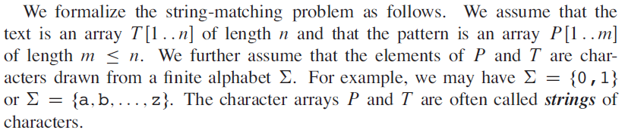
Definition of String Matching Problem:
So,given the string/Text and Pattern the problem is to find whether a pattern exists in a string/text and if exists , then find the index at which it exists.

Slide 5
The naive string-matching algorithm
Example 1:
String: abcdefgh
Pattern: def
String: abcdefgh
Pattern: def
String: abcdefgh
Pattern: def
String: abcdefgh
Pattern: def

Slide 6
The naive string-matching algorithm
Example 2
String: abcdabcabcdf
Pattern: abcdf
i->
1 2 3 4 5 6 7 8 9 10 11 12
j->
1 2 3 4 5
Problem: We are checking for the characters in the string again and again.i.e.we are backtracking on i in string .

Slide 7
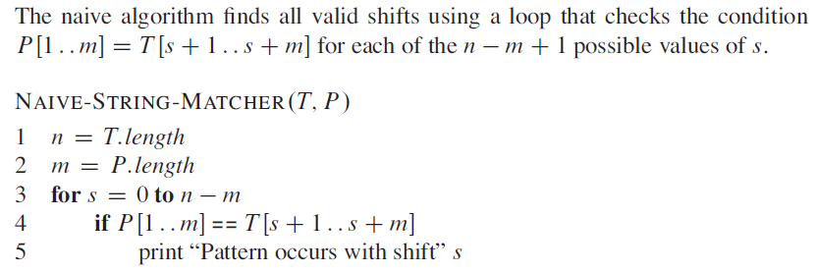
The naive string-matching algorithm
Time complexity?
O(mn)

Slide 8
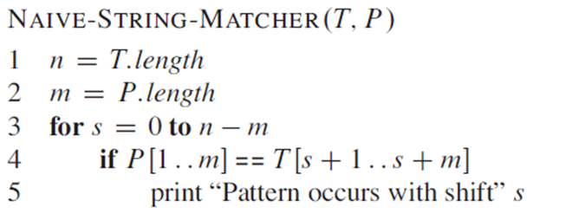
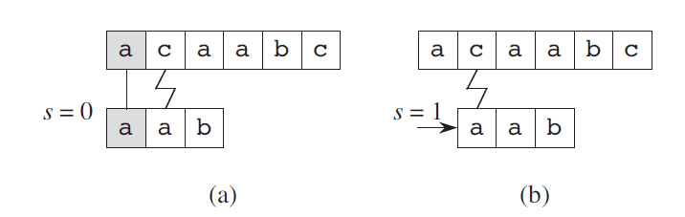
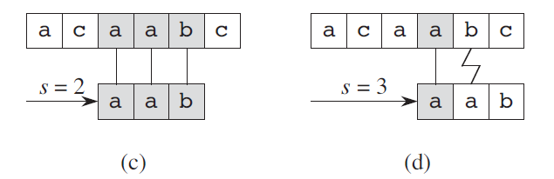
NAIVE-STRING-MATCHER : Working
1 2 3 4 5 6
1 2 3 4 5 6
1 2 3 4 5 6
1 2 3 4 5 6
As this algorithm does not need any preprocessing the running time is equal to matching time .
If string size is n and pattern size is m , then time taken by basic algorithm is O(mn).

Slide 9
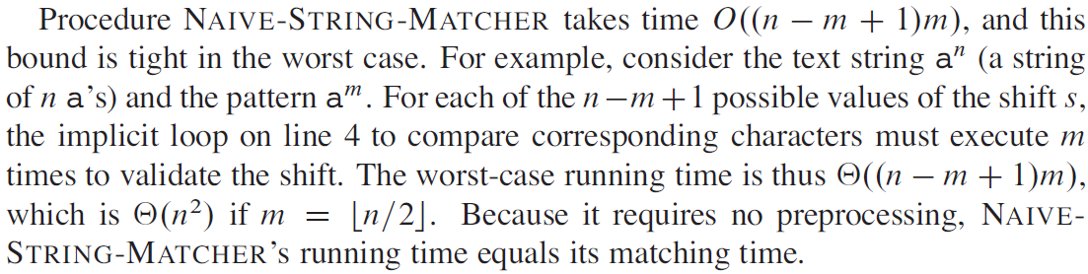
Analysis of NAIVE-STRING-MATCHER

Slide 10
Knuth-Morris-Pratt Algorithm

Slide 11
The Knuth-Morris-Pratt Algorithm
Knuth, Morris and Pratt proposed a linear time algorithm for the string matching problem.
A matching time of O(n) is achieved by avoiding comparisons with elements of ‘S’ that have previously been involved in comparison with some element of the pattern ‘p’ to be matched. i.e., backtracking on the string ‘S’ never occurs

Slide 12
Pattern: abcdabc
Prefix: a,ab,abc,abcd,…….
Suffix: c,bc,abc,dabc,……..
KMP algorithm observes whether the beginning part of the pattern(some prefix in the pattern) is appearing again anywhere else in a pattern or not.
i.e it checks if there is any prefix in the pattern which is same as suffix (of some substring of pattern)

Slide 13
Components of KMP algorithm
1. The prefix function, Π table,
-- lps(longest proper prefix of substring that is also a suffix in that substring)
-- The prefix function for the string is defined as an array Π of length n, where Π[i] is the length of the longest proper prefix of the substring S[0,1,2.....i] which is also a suffix of this substring.
-- A proper prefix of a string is a prefix that is not equal to the string itself.
2. The KMP Matcher

Slide 14
Components of KMP algorithm
The prefix function, Π table
The prefix function,Π for a pattern encapsulates knowledge about how the pattern matches against shifts of itself.
This information can be used to avoid useless shifts of the pattern ‘p’. In other words, this enables avoiding backtracking on the string ‘S’.
P1: abcdabeabf Π function: [0,0,0,0,1,2,0,1,2,0]
P2: abcdeabfabc
P3: aabcadaabe
0 0 0 0 1 2 0 1 2 0
Time taken ?
O(m)
0 0 0 0 0 1 2 0 1 2 3
0 1 0 0 1 0 1 2 3 0
P4 : aaaabaacd
0 1 2 3 0 1 2 0 0

Slide 15
The prefix function, Π
Following pseudocode computes the prefix fucnction, Π:
Compute-Prefix-Function (p)
1 m 🡨 length[p] //’p’ pattern to be matched
2 Π[1] 🡨 0
3 k 🡨 0
for q 🡨 2 to m
do while k > 0 and p[k+1] != p[q]
6 do k 🡨 Π[k]
If p[k+1] = p[q]
then k 🡨 k +1
Π[q] 🡨 k
10 return Π
Time taken ?
O(m)

Slide 16
Example: compute Π for the pattern ‘p’ below:
p
a | b | a | b | a | c | a
Initially: m = length[p] = 7
Π[1] = 0
k = 0
Step 1: q = 2, k=0
Π[2] = 0
Step 2: q = 3, k = 0,
Π[3] = 1
Compute-Prefix-Function (p)
1 m 🡨 length[p] //’p’ pattern to be matched
2 Π[1] 🡨 0
3 k 🡨 0
for q 🡨 2 to m
do while k > 0 and p[k+1] != p[q]
6 do k 🡨 Π[k]
If p[k+1] = p[q]
then k 🡨 k +1
Π[q] 🡨 k
10 return Π
q | 1 | 2 | 3 | 4 | 5 | 6 | 7
p | a | b | a | b | a | c | a
Π | 0 | 0
q | 1 | 2 | 3 | 4 | 5 | 6 | 7
p | a | b | a | b | a | c | a
Π | 0 | 0 | 1

Slide 17
Example: compute Π for the pattern ‘p’ below:
p
a | b | a | b | a | c | a
Step 3: q = 4, k = 1
Π[4] = 2
Step 4: q = 5, k =2
Π[5] = 3
Compute-Prefix-Function (p)
1 m 🡨 length[p] //’p’ pattern to be matched
2 Π[1] 🡨 0
3 k 🡨 0
for q 🡨 2 to m
do while k > 0 and p[k+1] != p[q]
6 do k 🡨 Π[k]
If p[k+1] = p[q]
then k 🡨 k +1
Π[q] 🡨 k
10 return Π
q | 1 | 2 | 3 | 4 | 5 | 6 | 7
p | a | b | a | b | a | c | A
Π | 0 | 0 | 1 | 2
q | 1 | 2 | 3 | 4 | 5 | 6 | 7
p | a | b | a | b | a | c | a
Π | 0 | 0 | 1 | 2 | 3

Slide 18
Example: compute Π for the pattern ‘p’ below:
p
a | b | a | b | a | c | a
Step 5: q = 6, k = 3
Π[6] = 1
Step 6: q = 7, k = 1
Π[7] = 1
After iterating 6 times, the prefix function computation is complete:
Compute-Prefix-Function (p)
1 m 🡨 length[p] //’p’ pattern to be matched
2 Π[1] 🡨 0
3 k 🡨 0
for q 🡨 2 to m
do while k > 0 and p[k+1] != p[q]
6 do k 🡨 Π[k]
If p[k+1] = p[q]
then k 🡨 k +1
Π[q] 🡨 k
10 return Π
q | 1 | 2 | 3 | 4 | 5 | 6 | 7
p | a | b | a | b | a | c | a
Π | 0 | 0 | 1 | 2 | 3 | 1
q | 1 | 2 | 3 | 4 | 5 | 6 | 7
p | a | b | a | b | a | c | a
Π | 0 | 0 | 1 | 2 | 3 | 1 | 1
q | 1 | 2 | 3 | 4 | 5 | 6 | 7
p | a | b | A | b | a | c | a
Π | 0 | 0 | 1 | 2 | 3 | 1 | 1

Slide 19
Components of KMP algorithm
2. The KMP Matcher
With string ‘S’, pattern ‘p’ and prefix function ‘Π’ as inputs, finds the occurrence of ‘p’ in ‘S’ and returns the number of shifts of ‘p’ after which occurrence is found.

Slide 20

KMP Matcher Example
String: ababcabcabababd
Pattern: ababd
Time Complexity?
O(m+n)
m=Time for preparing Pi table
n= Time required for parsing through a string.
a | b | a | b | d
0 | 0 | 1 | 2 | 0
Table
Working of KMP Matcher:
Index 0 acts as the starting point of pattern p
String[i] is compared with Pattern[j+1]. If matched, move j as well as i
If not matched, move j to value of jth character specified in Pi table .
If not matched and j=0, we can not move j further to left, so move i to next position in the string
With this KMP, observe that only j is moving, i is not backtracking

Slide 21
So, Basic idea of KMP algorithm is that if beginning part of the pattern is appearing again somewhere in the text then dont again compare those characters . i.e Avoid the same comparison and hence avoid backtracking on S.

Slide 22
The KMP Matcher
The KMP Matcher, with pattern ‘p’, string ‘S’ and prefix function ‘Π’ as input, finds a match of p in S.
Following pseudocode computes the matching component of KMP algorithm:
KMP-Matcher(S,p)
1 n 🡨 length[S]
2 m 🡨 length[p]
3 Π 🡨 Compute-Prefix-Function(p)
4 q 🡨 0 //number of characters matched
5 for i 🡨 1 to n //scan S from left to right
6 do while q > 0 and p[q+1] != S[i]
do q 🡨 Π[q] //next character does not match
if p[q+1] = S[i]
then q 🡨 q + 1 //next character matches
if q = m //is all of p matched?
then print “Pattern occurs with shift” i – m
q 🡨 Π[ q] // look for the next match
Note: KMP finds every occurrence of a ‘p’ in ‘S’. That is why KMP does not terminate in step 12, rather it searches remainder of ‘S’ for any more occurrences of ‘p’.
TC=O(n)

Slide 23
Running - time analysis
Compute-Prefix-Function (Π)
1 m 🡨 length[p] //’p’ pattern to be matched
2 Π[1] 🡨 0
3 k 🡨 0
for q 🡨 2 to m
do while k > 0 and p[k+1] != p[q]
6 do k 🡨 Π[k]
If p[k+1] = p[q]
then k 🡨 k +1
Π[q] 🡨 k
return Π
In the above pseudocode for computing the prefix function, the for loop from step 4 to step 10 runs ‘m’ times. Step 1 to step 3 take constant time. Hence the running time of compute prefix function is Θ(m).
KMP Matcher
1 n 🡨 length[S]
2 m 🡨 length[p]
3 Π 🡨 Compute-Prefix-Function(p)
4 q 🡨 0
5 for i 🡨 1 to n
6 do while q > 0 and p[q+1] != S[i]
do q 🡨 Π[q]
if p[q+1] = S[i]
then q 🡨 q + 1
if q = m
then print “Pattern occurs with shift” i – m
q 🡨 Π[ q]
The for loop beginning in step 5 runs ‘n’ times, i.e., as long as the length of the string ‘S’. Since step 1 to step 4 take constant time, the running time is dominated by this for loop. Thus running time of matching function is Θ(n).

Slide 24
Illustration: given a String ‘S’ and pattern ‘p’ as follows:
S
b | a | c | b | a | b | a | b | a | b | a | c | a | c | a
p
a | b | a | b | a | c | a
Let us execute the KMP algorithm to find whether ‘p’ occurs in ‘S’.
For ‘p’ the prefix function, Π was computed previously and is as follows:
q | 1 | 2 | 3 | 4 | 5 | 6 | 7
p | a | b | a | b | a | c | a
Π | 0 | 0 | 1 | 2 | 3 | 0 | 1

Slide 25
Initially: n = size of S = 15;
m = size of p = 7
Step 1: i = 1, q = 0
comparing p[1] with S[1] compare p[q+1] with S[i]
S
b | a | c | b | a | b | a | b | a | b | a | c | a | a | b
p
a | b | a | b | a | c | a
P[1] does not match with S[1]. ‘p’ will be shifted one position to the right.
Step 2: i = 2, q = 0
comparing p[1] with S[2]
S
b | a | c | b | a | b | a | b | a | b | a | c | a | a | b
p
a | b | a | b | a | c | a
P[1] matches S[2]. Since there is a match, p is not shifted.

Slide 26
Step 3: i = 3, q = 1
Comparing p[2] with S[3]
p[2] does not match with S[3]
S
b | a | c | b | a | b | a | b | a | b | a | c | a | a | b
p
a | b | a | b | a | c | a
Backtracking on p, comparing p[1] and S[3]
Step 4: i = 4, q = 0
comparing p[1] with S[4]
p[1] does not match with S[4]
S
b | a | c | b | a | b | a | b | a | b | a | c | a | a | b
p
a | b | a | b | a | c | a
Step 5: i = 5, q = 0
comparing p[1] with S[5]
p[1] matches with S[5]
S
b | a | c | b | a | b | a | b | a | b | a | c | a | a | b
p
a | b | a | b | a | c | a

Slide 27
Step 6: i = 6, q = 1
Comparing p[2] with S[6]
p[2] matches with S[6]
S
b | a | c | b | a | b | a | b | a | b | a | c | a | a | b
p
a | b | a | b | a | c | a
Step 7: i = 7, q = 2
Comparing p[3] with S[7]
p[3] matches with S[7]
S
b | a | c | b | a | b | a | b | a | b | a | c | a | a | b
p
a | b | a | b | a | c | a
Step 8: i = 8, q = 3
Comparing p[4] with S[8]
p[4] matches with S[8]
S
b | a | c | b | a | b | a | b | a | b | a | c | a | a | b
p
a | b | a | b | a | c | a

Slide 28
Step 9: i = 9, q = 4
Comparing p[5] with S[9]
p[5] matches with S[9]
S
b | a | c | b | a | b | a | b | a | b | a | c | a | a | b
p
a | b | a | b | a | c | a
Step 10: i = 10, q = 5
Comparing p[6] with S[10]
p[6] doesn’t match with S[10]
S
b | a | c | b | a | b | a | b | a | b | a | c | a | a | b
p
a | b | a | b | a | c | a
Backtracking on p, comparing p[4] with S[10] because after mismatch q = Π[5] = 3
Step 11: i = 11, q = 4
Comparing p[5] with S[11]
p[5] matches with S[11]
b | a | c | b | a | b | a | b | a | b | a | c | a | a | b
S
p
a | b | a | b | a | c | a

Slide 29
Step 12: i = 12, q = 5
Comparing p[6] with S[12]
p[6] matches with S[12]
S
b | a | c | b | a | b | a | b | a | b | a | c | a | a | b
p
a | b | a | b | a | c | a
Step 13: i = 13, q = 6
Comparing p[7] with S[13]
p[7] matches with S[13]
S
b | a | c | b | a | b | a | b | a | b | a | c | a | a | b
p
a | b | a | b | a | c | a
Pattern ‘p’ has been found to completely occur in string ‘S’. The total number of shifts
that took place for the match to be found are: i – m = 13 – 7 = 6 shifts.

Slide 30
The Rabin-Karp algorithm

Slide 31
Basic Idea of Rabin Karp Algorithm
Example 1:
String(n=6): aaaaab
Pattern(m=3): aab
Let us use the Codes: a=1,b=2,c=3………………………….h=8,i=9,j=10.
Pattern (P)= aab=1+1+2=4 -----hash code of pattern
Compare hash code of pattern with the numeric value of a substring(of length m=3),say aaa(hash code=3) in the given String .
Check for each possible substring of length 3 until you get matched hash code.
For last substring aab, hash code matches. So now check alphabets in pattern and substring.
Convert the pattern(of length m) into a single numeric value and compare it with the numeric value of a subtring(of length m) in the given String.
If matching then there is a possibility that pattern is present in a string. So, check alphabets of pattern with that of the substring.

Slide 32
Basic Idea of Rabin Carp Algorithm
Example 2:
String(n=8): abcdabce
Pattern(m=3): bce
Let us use the Codes: a=1,b=2,c=3………………………….h=8,i=9,j=10.
Pattern (P)= bce=2+3+5=10 -----hash code of pattern
In Ex1 and Ex2, we are going through the text only once and we are checking the pattern only once. So average time required = θ(n-m+1)

Slide 33
Rabin Carp Algorithm :Drawback
Example 3(Worst case )
String(n=6): ccaccaaedba
Pattern(m=3): dba
Let us use the Codes: a=1,b=2,c=3………………………….h=8,i=9,j=10.
Pattern (P)= dba=4+2+1=7 -----hash code of pattern
Drawback: Waste hits/Spurious hits : With a very simple hash function like addition,it may happen that many times Hash values of pattern and substring of text(of length m) matches but the pattern does not exist.
Worst case time complexity = θ (mn)

Slide 34
Idea of hash function suggested by Rabin Carp
Rabin Fingerprint function
Example 3
String(n=6): ccaccaaedba
Pattern(m=3): dba
H(p)= P[1] x 10^{m-1} + P[2] x 10^{m-2} + P[3] x 10^{m-3} + ……… +P[m] x 10^{m-m} Why 10? 10 is a base.
=4 x 10² + 2 x 10¹ + 1 x 10⁰ = 421 =421
This hash function defined by Rabin Carp is a rolling hash function which is a base power function is also called Rabin Fingerprint function.
No spurious Hits occured with Rabin Fingerprint function. Possibility of spurious hits is reduced with this function.
Best case time complexity=O(n-m+1)
Worst case: O(mn)

Slide 35
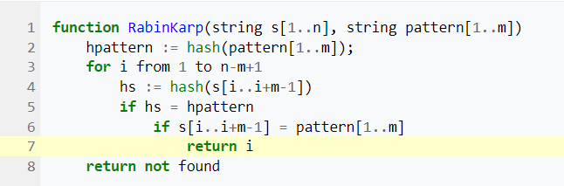
Rabin–Karp algorithm
Analysis:
The complexity becomes O(m(n − m + 1)) in the worst case.
It may be noted though that the number of comparisons are reduced as compared to naïve string matching.

Slide 36
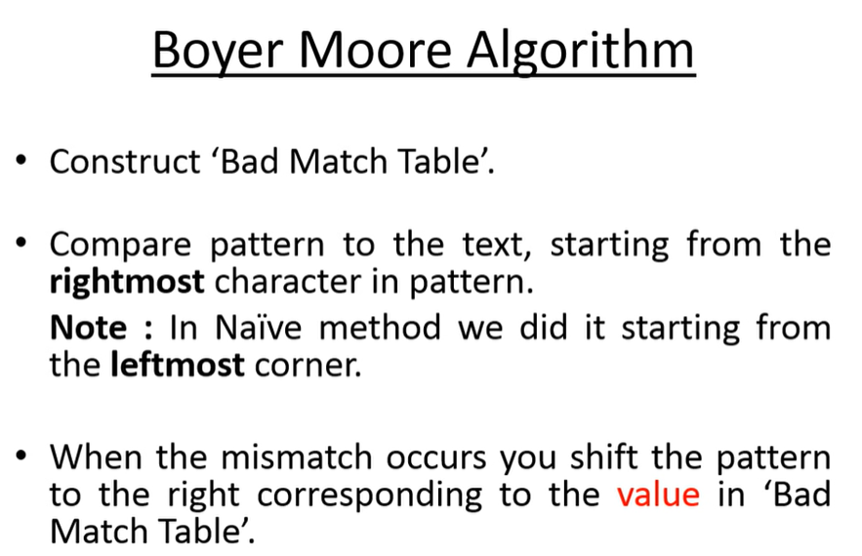
Boyer Moore Algorithm
https://www.youtube.com/watch?v=G-h1Dph9IOE
The character of the text which doesn’t match with the current character of the pattern is called the Bad Character.
When characters do not match, the search jumps to the next matching position in the pattern by the value indicated in the Bad Match Table. The Bad Match Table indicates how many jumps should it move from the current position to the next.

Slide 37
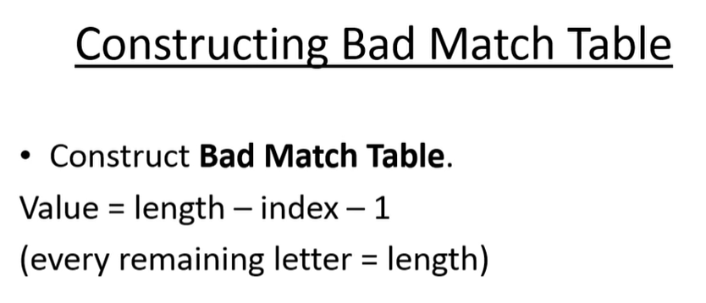
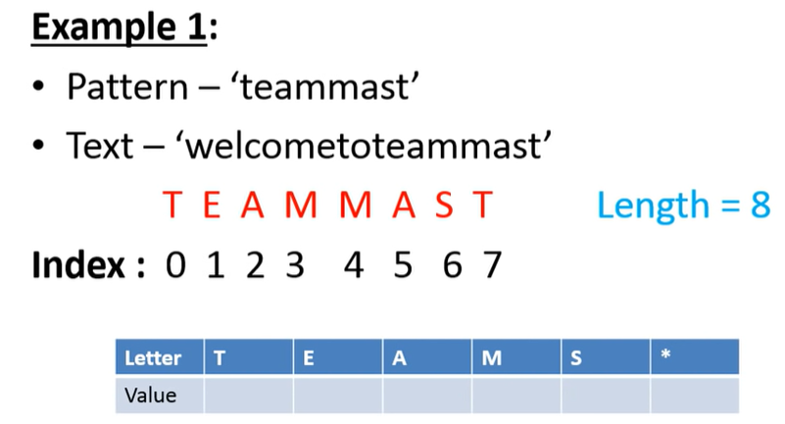
Step 1
Value of * = length of pattern

Slide 38
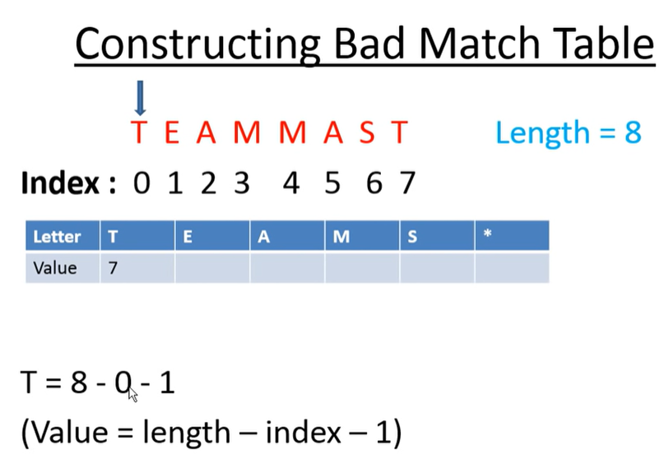
Each letter in the string has only one entry in the table.
If any letter appears more than once, overwrite its value in the table at each occurrence.

Slide 39






8
6
5 2
4 3
1
8
Value of any other letter represented by * is taken equal to length of pattern string (8 in this ex)
Last character in pattern has bad match value =length of pattern

Slide 40

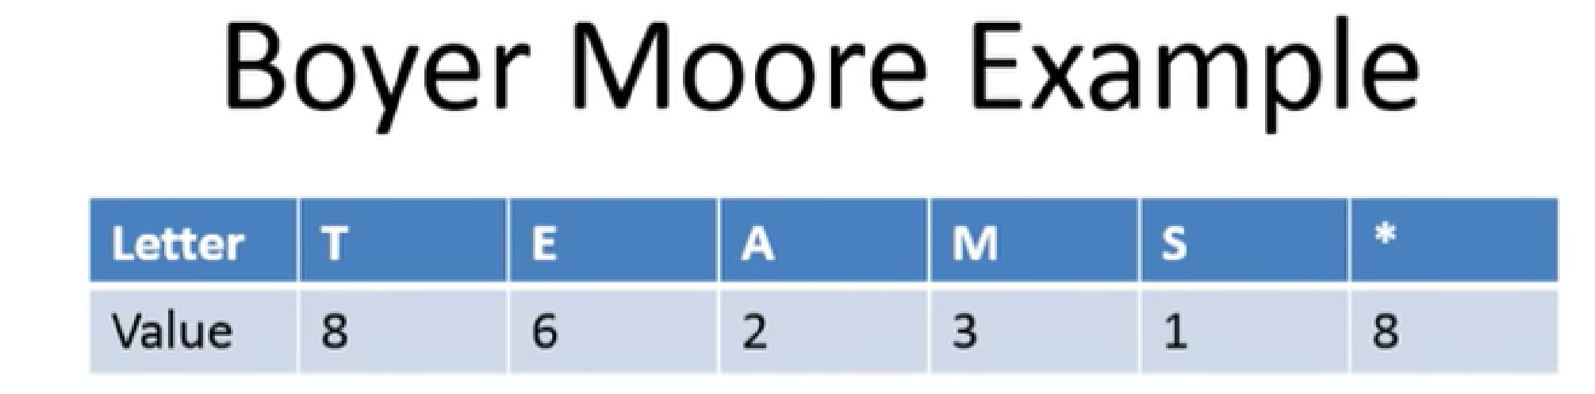
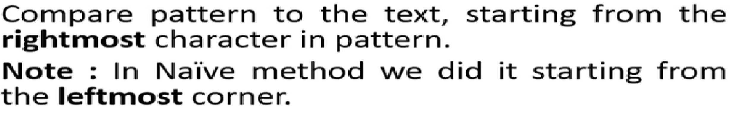
Step 1
Step 2 :
Start with rightmost character in a pattern . If it is matching with corresponding character in a string, then match the second last character of the pattern.

Slide 41
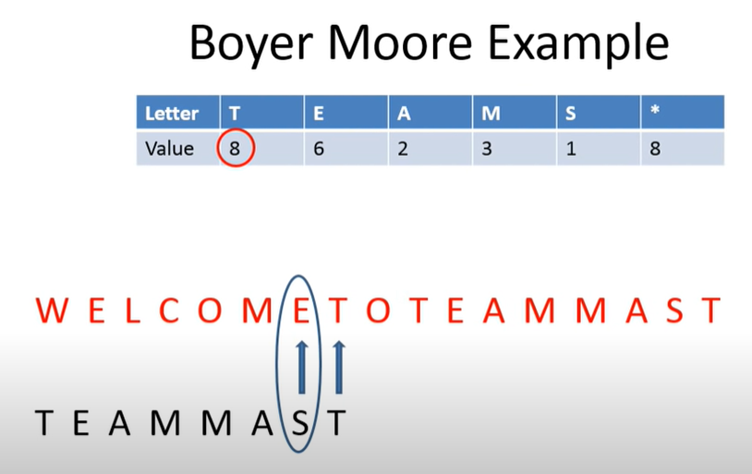
Second last character is not matching, so look at value of character in the text at which we started matching process i.e. T( value is 8). So now move our pattern 8 positions to the right.

Slide 42
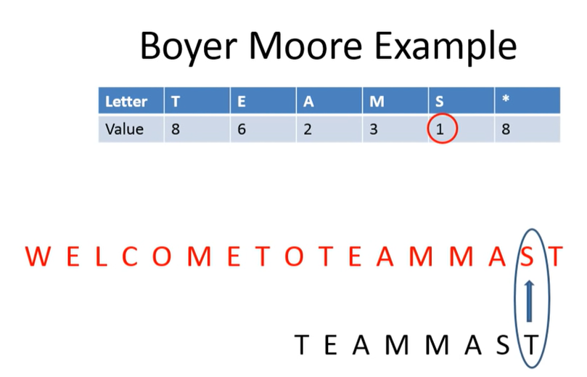
The rightmost character of pattern is not matching, so look at value of character in the text at which we started i.e. S ( value is 1). So now move our pattern 1 position to the right.

Slide 43
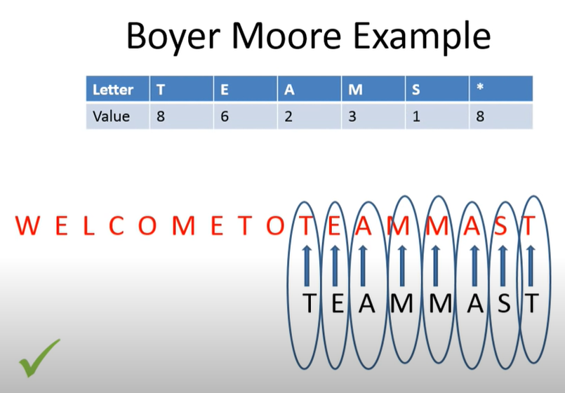
Now starting from rightmost character, all characters in the pattern are matching with corresponding characters in a string. So pattern is found.

Slide 44
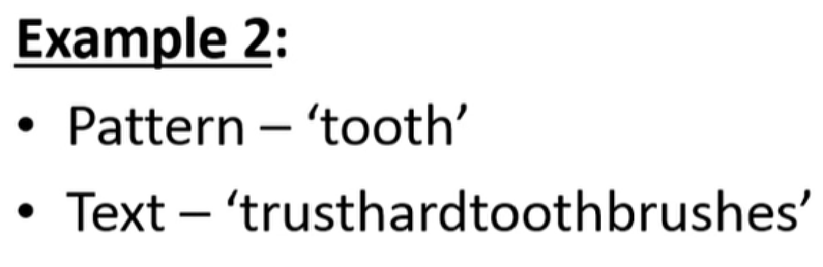

Slide 45
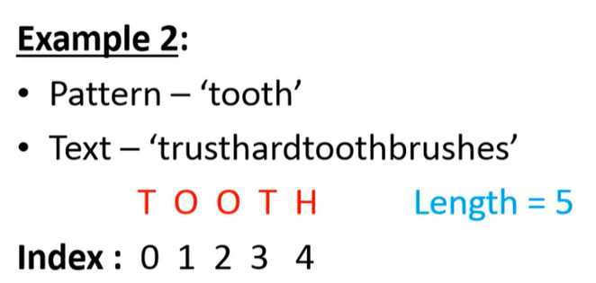
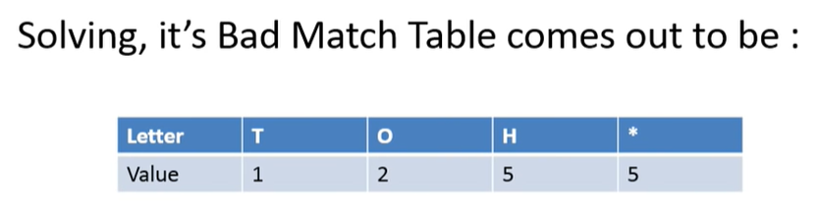

Slide 46
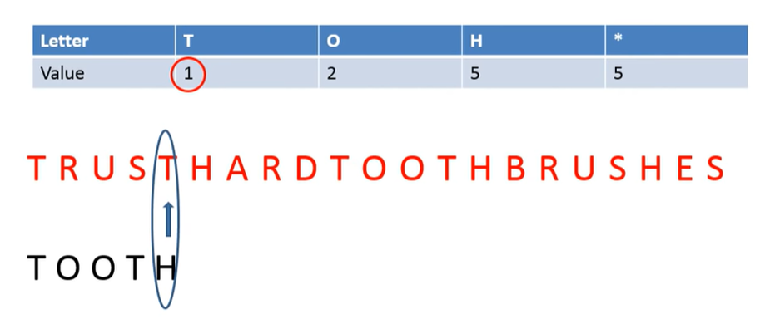

Slide 47
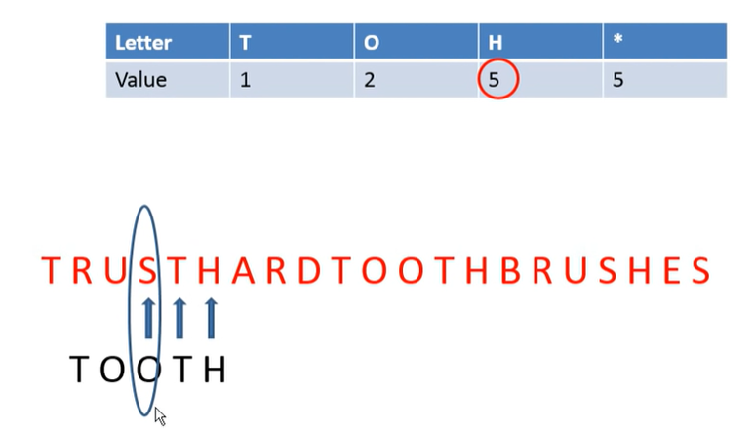

Slide 48
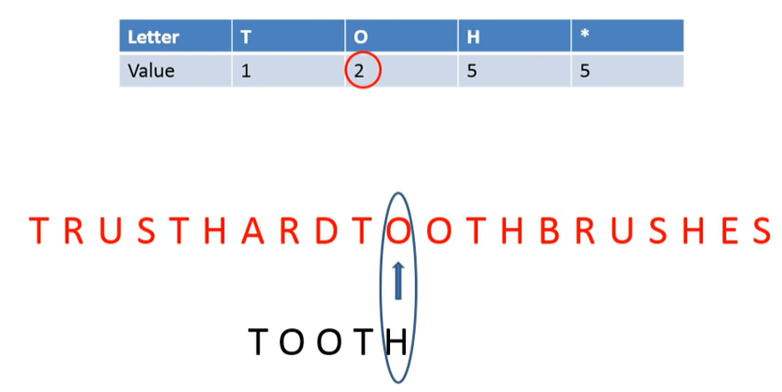

Slide 49
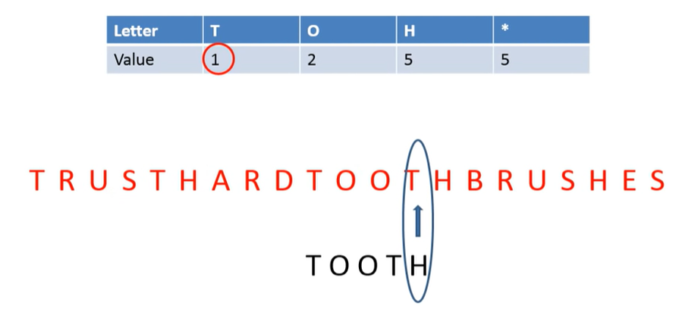

Slide 50

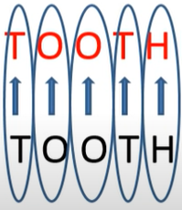

Slide 51
Time Complexity: O(mxn)

Slide 52
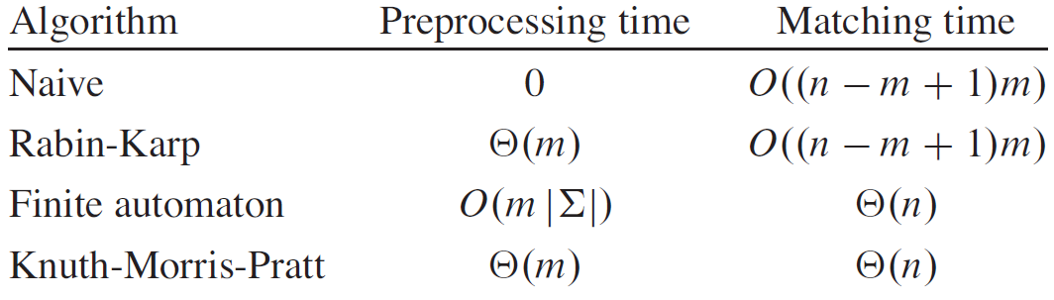
Few String Matching Algorithms and their preprocessing and matching time

